Slide 1
Mini MAP
A map which helps to find your spot inside ur campus
Works Offline !!!
SRM RMP
BCA A 2ndyear,
Barath
Sanjay
Jeeva

Slide 2
INTRODUCTION :
Our project is handy travel solution for faculties and students with live location tracking.
This map can be used in many places like theme parks , colleges and more clumsy places to find your destination easily.
This map is more sensible and accurate to track your small movements.
This maps would be beneficial. Not only that you need not worry about connection, but also you can save your data.

Slide 3
ABSTRACT
All navigator apps requires a internet connection offer their services and internet is luxury that isn’t available everywhere.
You can have free maps forever and can download an unlimited number of maps.
We use A* Algorithm for finding shortest-path.
You can find a lot of interesting places with paths and routes that you can’t find with other maps.
You can save your favorite spot and share it with others.

Slide 4
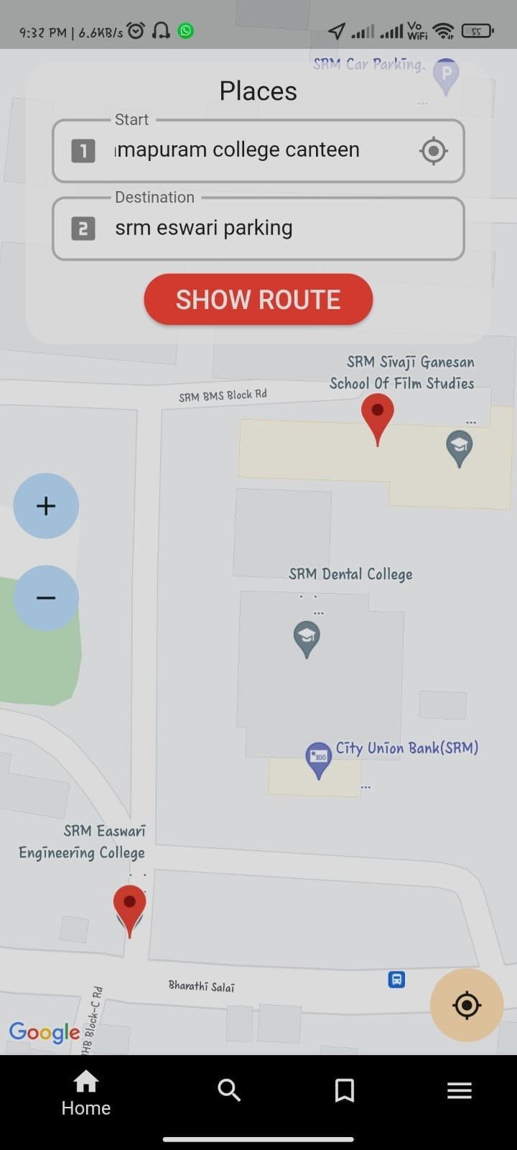
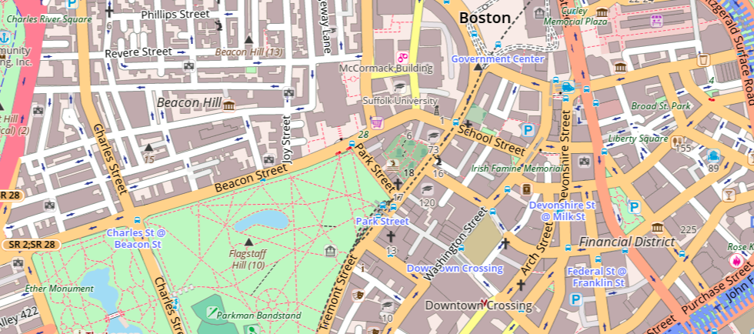
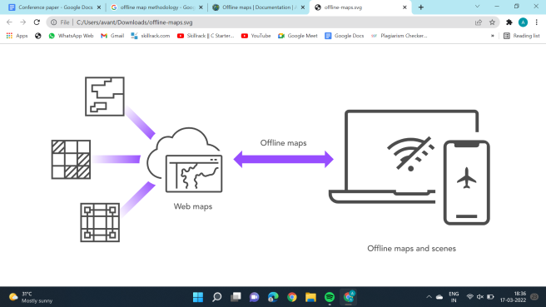
Views of maps :
OFF-LINE
DEFAULT VIEW
CAMPUS VIEW

Slide 5
PROPOSED METHODOLOGY
Routing
Search
Shows routes
Uses location
Uses location
Displays
Tracking
Transit
Android Studio
Flutter & Dart
Android
IOS

Slide 6
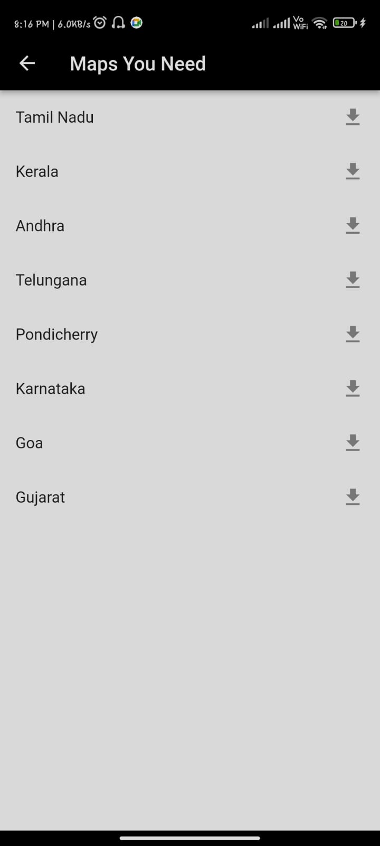
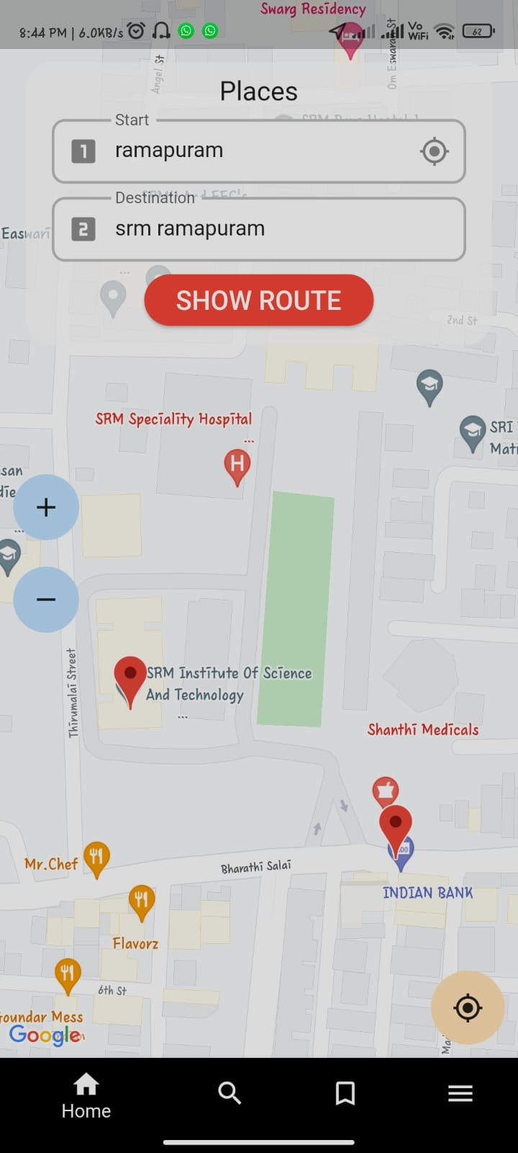
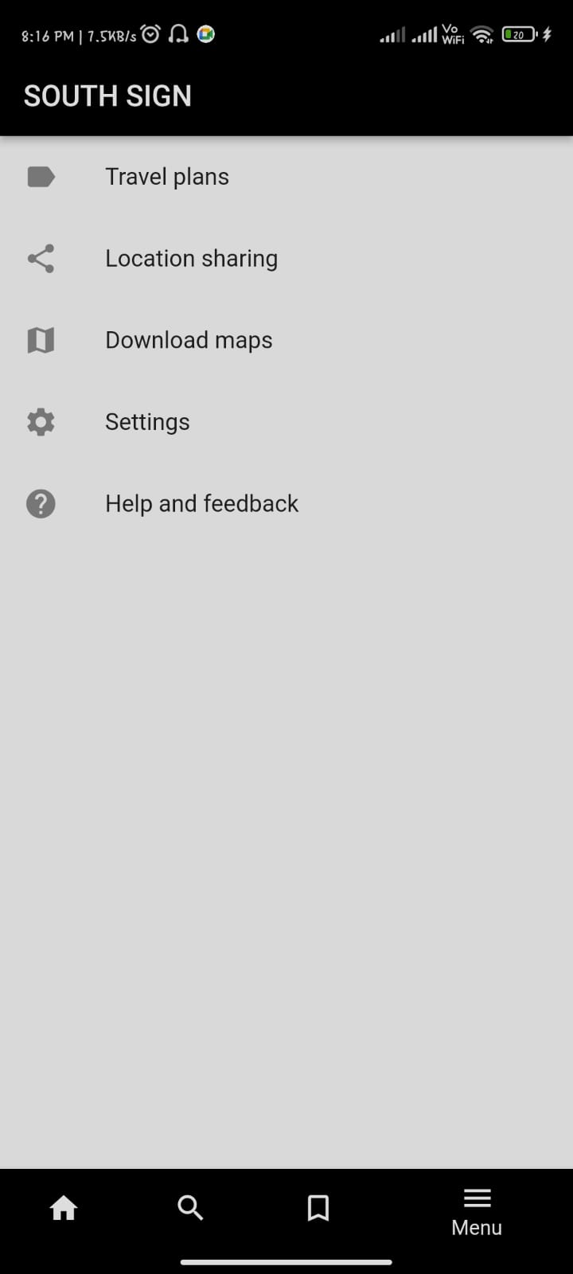
IMPLEMENTATION

Slide 7
EXISTING WORK
Our app would require only less room in your smart phone , we will be using optimized maps .This would be more advantageous
Once the map is loaded there is no need of internet connection we can track our live location easily without network
Maps can me downloaded based on the college you study or you are going to Explore.

Slide 8
REFERENCES
Author-Peter Cooper –”GPS-based Mobile Cross-platform Cargo Tracking System with Web-based Application”(2020).
Author-Prabhu Ram Nagarajan,Vibin Mammen Vinod,Mekala V,Manimegalai M- “Fast And Energy Efficient Path Planning Algorithm For Offline Navigation Using Svm Classifier”.(2020)
Author-Shifali Tandon,Shrutika Singhal,Sireen Khan,Mr Pushpendra Kumar-”GPS System based Tracking model for Mobile phone”(2021)
Author- Guo-Shing Huang, Po-Chun Hsu, Ming-Cheng Kao-”Navigation Technology Using Inertial Elements to Compensate for GPS Signal-Shaded in Real Time”(2020).

